Slide 1
Complete Mathematical Formulation of PCA for RGB Image Compression
علیرضا بهمن زاده
درس: مبانی جبر
استاد: دکتر تهرانیان

Slide 2
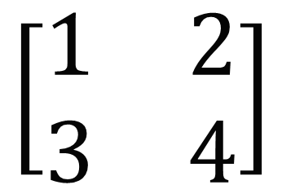
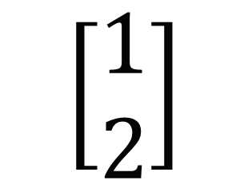

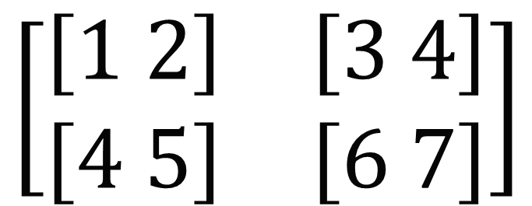
Scaler
Vector
Matrix
Tensor
$$\left[\begin{matrix}1 \\ 2\end{matrix}\right]$$
$$\left[\begin{matrix}1 & 2 \\ 3 & 4\end{matrix}\right]$$
$$\left[\begin{matrix}\left[1 2\right] & \left[3 4\right] \\ \left[4 5\right] & \left[6 7\right]\end{matrix}\right]$$
$$1$$

Slide 3
1. Image representation

Slide 4
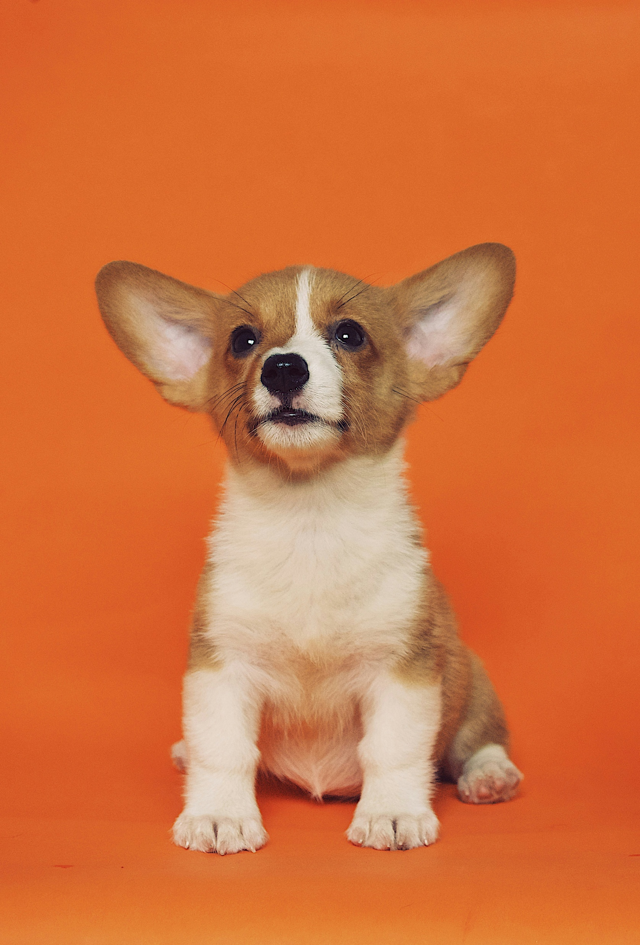
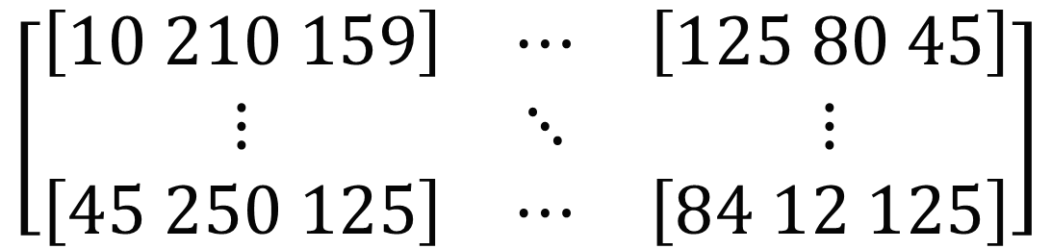

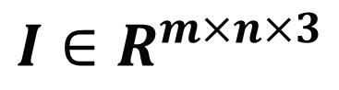
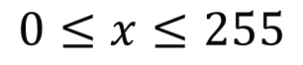
$$0≤x≤255$$
$$\left[\begin{matrix}\left[10 210 159\right] & ⋯ & \left[125 80 45\right] \\ ⋮ & ⋱ & ⋮ \\ \left[45 250 125\right] & ⋯ & \left[84 12 125\right]\end{matrix}\right]$$
$$m×n$$
$$I∈R^{m×n×3}$$

Slide 5
2. Normalization

Slide 6
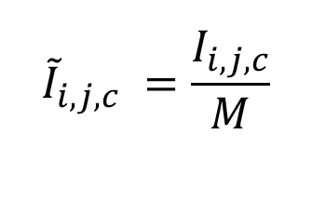

Define the maximum pixel intensity
$$M=\max_{1≤i≤m, 1≤j≤n, 1≤c≤3}{I_{i,j,c}}.$$
The normalized image:
$${\tilde{I}}_{i,j,c} =\frac{I_{i,j,c}}{M}$$
for all 𝑖,𝑗,c

Slide 7
3. Channel extraction

Slide 8



$$B:Blue, G:Green, R:Red$$
$$B_{i,j}={\tilde{I}}_{i,j,1},$$
$$G_{i,j}={\tilde{I}}_{i,j,2},$$
$$R_{i,j}={\tilde{I}}_{i,j,3}.$$
$$Each of R,G,B is in{ R}^{m×n}.$$

Slide 9
4. Mean centering

Slide 10

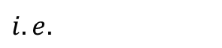
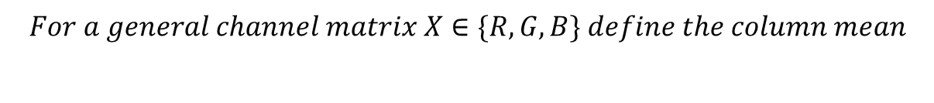

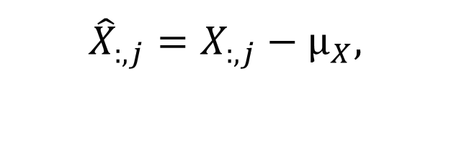
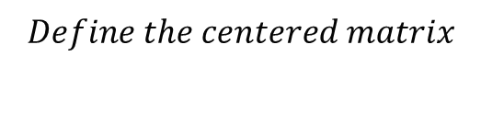
$$For a general channel matrix X∈\{R,G,B\} define the column mean$$
$$μ_{X}=\frac{1}{n}\sum_{j=1}^{n}{X_{:,j}}∈R^{m}.$$
$$Define the centered matrix$$
$${\hat{X}}_{:,j}=X_{:,j}−μ_{X},$$
$i.e.$
$$\hat{R}, \hat{G}, \hat{B}∈R^{m×n}$$

Slide 11
5. Covariance matrices

Slide 12
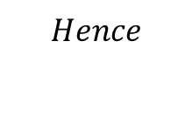
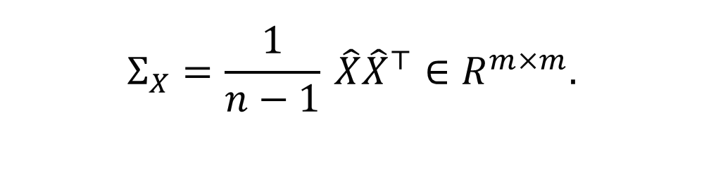
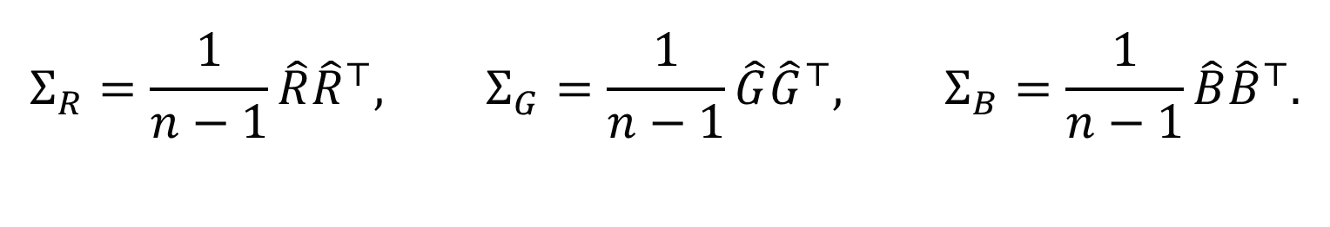
$$For any centered channel \hat{X }the sample covariance matrix \left(columns as observations\right) is$$
$$Σ_{X}=\frac{1}{n−1} \hat{X}{\hat{X}}^{⊤}∈R^{m×m}.$$
$$Hence$$
$$Σ_{R}=\frac{1}{n−1}\hat{R}{\hat{R}}^{⊤}, Σ_{G}=\frac{1}{n−1}\hat{G}{\hat{G}}^{⊤}, Σ_{B}=\frac{1}{n−1}\hat{B}{\hat{B}}^{⊤}.$$

Slide 13
6. Eigenvalue decomposition

Slide 14
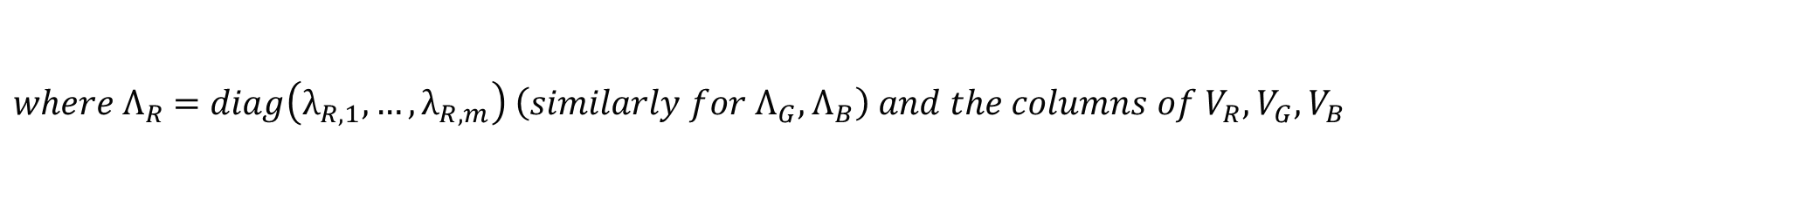
$$For each channel compute the eigen−decomposition:$$
$$Σ_{R}V_{R}=V_{R}Λ_{R}, Σ_{G}V_{G}=V_{G}Λ_{G}, Σ_{B}V_{B}=V_{B}Λ_{B},$$
$where Λ_{R}$ $=diag\left(λ_{R,1},…,λ_{R,m}\right) \left(similarly for Λ_{G},Λ_{B}\right) and the columns of V_{R},V_{G},V_{B}$
$$are the corresponding eigenvectors v_{R,i},v_{G,i},v_{B,i} .$$

Slide 15
7. Sorting eigenvalues and eigenvectors

Slide 16

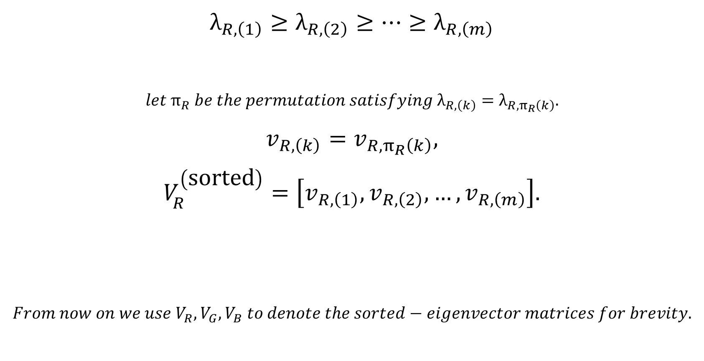
$$λ_{R,\left(1\right)}≥λ_{R,\left(2\right)}≥⋯≥λ_{R,\left(m\right)}$$
$$let π_{R} be the permutation satisfying λ_{R,\left(k\right)}=λ_{R,π_{R}\left(k\right)}.$$
$$v_{R,\left(k\right)}=v_{R,π_{R}\left(k\right)},$$
$$V_{R}^{\left(\text{sorted}\right)}=\left[v_{R,\left(1\right)},v_{R,\left(2\right)},…,v_{R,\left(m\right)}\right].$$
$$From now on we use V_{R},V_{G},V_{B} to denote the sorted−eigenvector matrices for brevity.$$
$$Similarly define V_{G}^{\left(\text{sorted}\right)},V_{B}^{\left(\text{sorted}\right)}.$$

Slide 17
8. Select top-k principal components

Slide 18
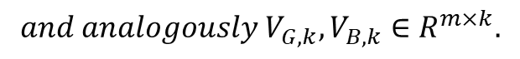
$$For a given \left(k\right) with \left(1≤k≤m\right) define the top−\left(k\right) eigenvector matrices$$
$$V_{R,k}=\left[v_{R,\left(1\right)},…,v_{R,\left(k\right)}\right]∈R^{m×k},$$
$$and analogously V_{G,k},V_{B,k}∈R^{m×k}.$$

Slide 19
9. Projection (dimensionality reduction)

Slide 20
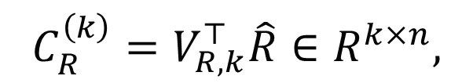



$$Project the centered channel data onto the (k)−dimensional subspace:$$
$$C_{R}^{\left(k\right)}=V_{R,k}^{⊤}\hat{R}∈R^{k×n},$$
$$C_{G}^{\left(k\right)}=V_{G,k}^{⊤}\hat{G},$$
$$C_{B}^{\left(k\right)}=V_{B,k}^{⊤}\hat{B}.$$

Slide 21
10. Inverse transformation (reconstruction)

Slide 22
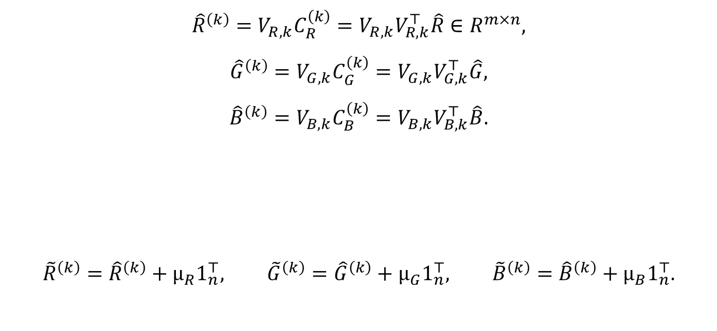
$$Reconstruct the centered channels from reduced coordinates:$$
$${\hat{R}}^{\left(k\right)}=V_{R,k}C_{R}^{\left(k\right)}=V_{R,k}V_{R,k}^{⊤}\hat{R}∈R^{m×n},$$
$${\hat{G}}^{\left(k\right)}=V_{G,k}C_{G}^{\left(k\right)}=V_{G,k}V_{G,k}^{⊤}\hat{G},$$
$${\hat{B}}^{\left(k\right)}=V_{B,k}C_{B}^{\left(k\right)}=V_{B,k}V_{B,k}^{⊤}\hat{B}.$$
$${\tilde{R}}^{\left(k\right)}={\hat{R}}^{\left(k\right)}+μ_{R}1_{n}^{⊤}, {\tilde{G}}^{\left(k\right)}={\hat{G}}^{\left(k\right)}+μ_{G}1_{n}^{⊤}, {\tilde{B}}^{\left(k\right)}={\hat{B}}^{\left(k\right)}+μ_{B}1_{n}^{⊤}.$$
$$Add the column means back to obtain reconstructed \left(non−centered\right) channels:$$

Slide 23
11. Combine reconstructed channels
into RGB image

Slide 24

$$Stack the reconstructed channels to form the rank−(k) reconstructed image:$$
$${\tilde{I}}^{\left(k\right)}=stack\left({\tilde{B}}^{\left(k\right)},{\tilde{G}}^{\left(k\right)},{\tilde{R}}^{\left(k\right)}\right)∈R^{m×n×𝟛},$$

Slide 25


Slide 26
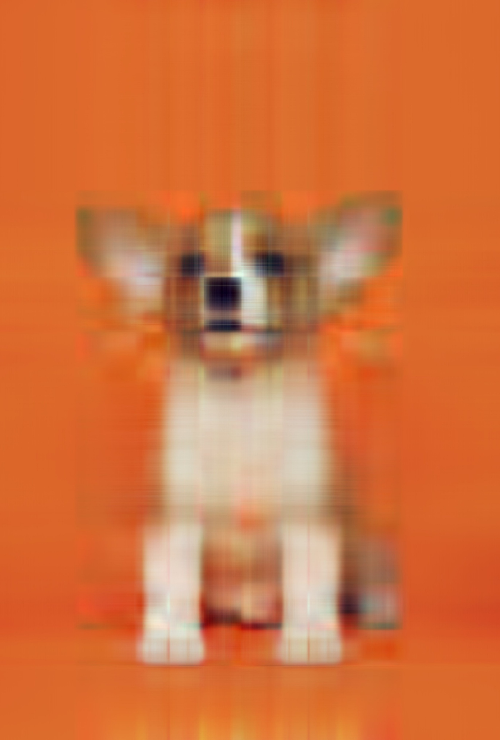
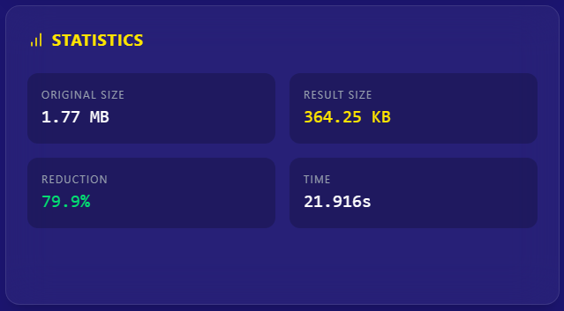

$$k=5$$

Slide 27
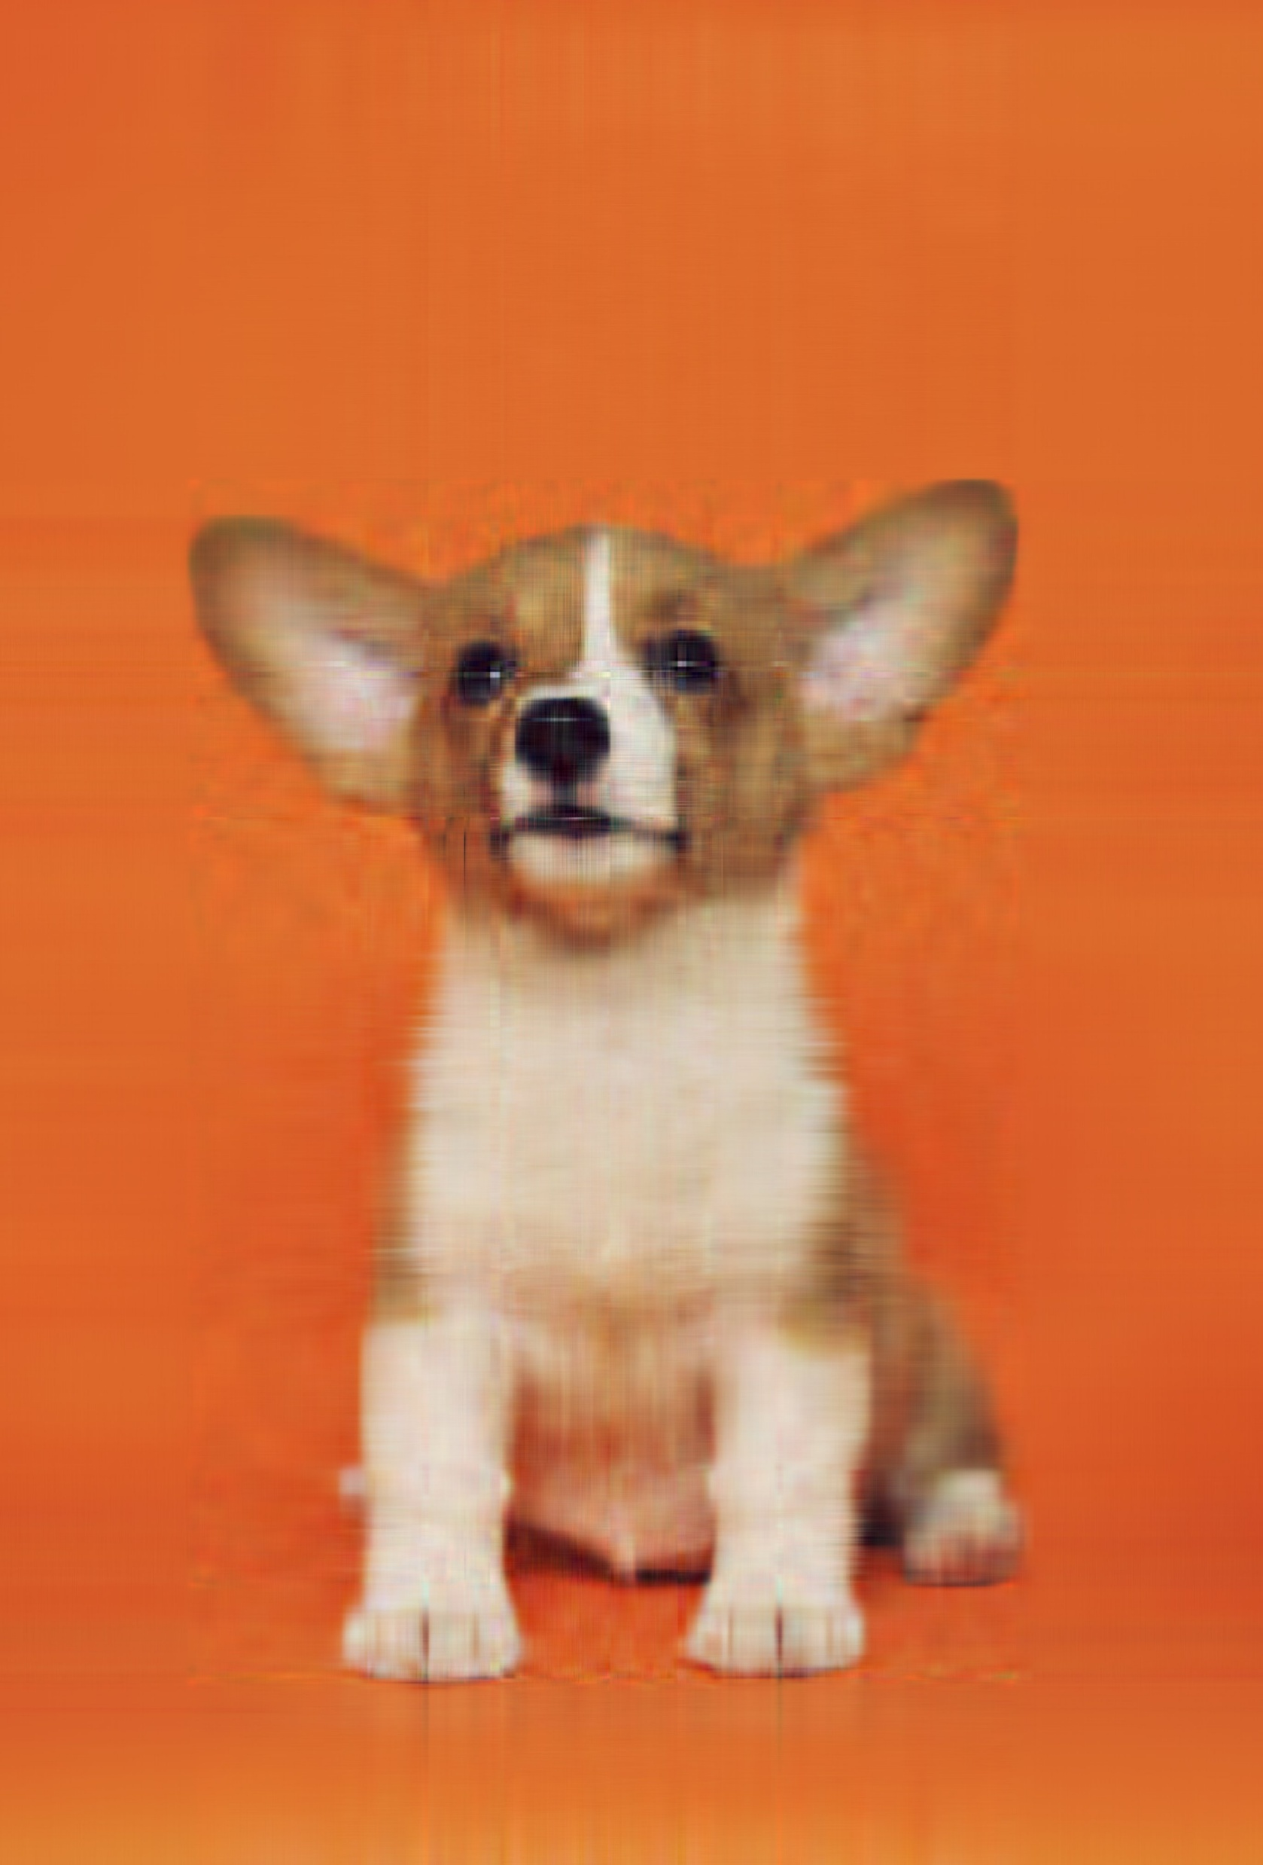
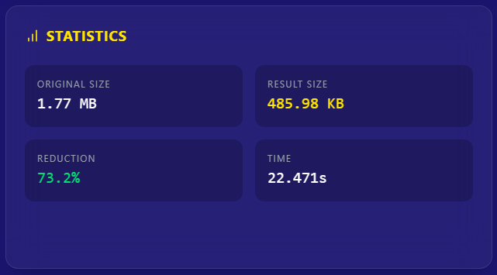

$$k=20$$

Slide 28

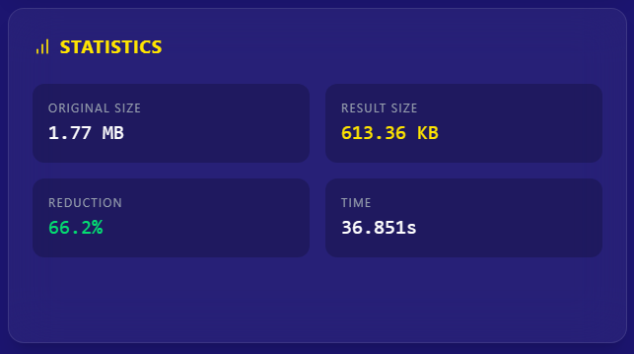

$$k=50$$

Slide 29

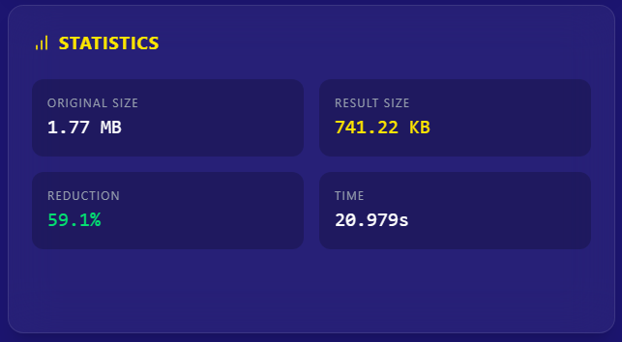

$$k=100$$

Slide 30

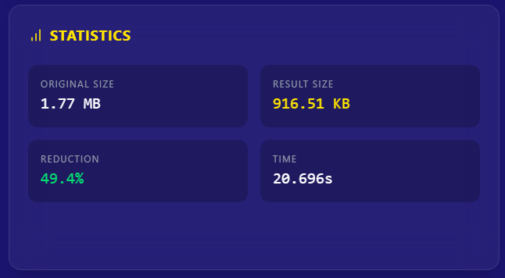

$$k=200$$

Slide 31
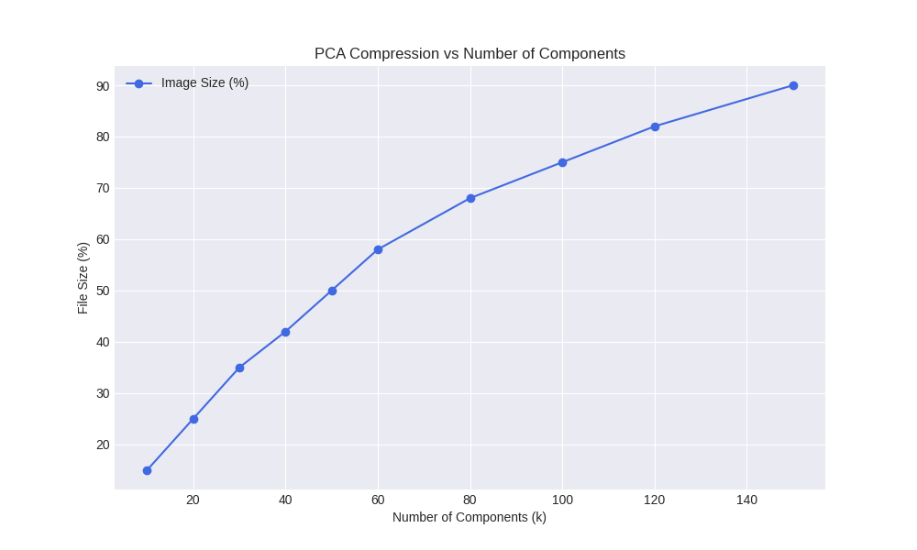

Slide 32
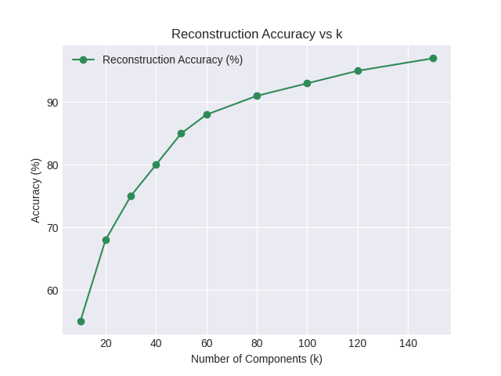

Slide 33
